Slide 1
Data Structures and Algorithms -3 (25CS2103E)
LOGISTICS OPTIMISATION SYSTEM
Team Members
Meghana-2520030461
Bhavya-2520030005
Koushika-2520030459
Under the Esteemed Guidance of Dr.Yamini Devi
Name of the DSA-3 faculty name with designation and department

Slide 2
Contents
Abstract
Introduction
Literature survey
Problem Statement and Objectives
Hardware and Software requirements
Results
Conclusion
Future Scope

Slide 3
Abstract
Transportation is a major component of supply-chain management, and inefficient route selection can lead to increased costs, underutilization of resources, and delays in delivering goods. When multiple warehouses, destinations, route capacities, and transportation costs are involved, manually determining the best shipment allocation becomes difficult. This project addresses this challenge by modeling the transportation system as a network-flow problem, where warehouses act as supply nodes, destinations as demand nodes, and transportation routes as capacity- and cost-constrained edges. The system aims to provide an efficient algorithmic approach for optimizing the movement of goods and reducing overall transportation expenses.

Slide 4
Introduction
The Logistics Optimization System uses the Minimum-Cost Maximum-Flow (MCMF) algorithm to determine optimal shipment quantities and routes while satisfying supply, demand, and capacity constraints. The project applies advanced algorithm concepts including flow networks, maximum flow, residual graphs, augmenting paths, flow conservation, and the Successive Shortest Path (SSP) approach. The system generates route-wise shipment details, total transportation cost, and network visualizations, helping improve resource utilization and reduce unnecessary transportation expenses. It demonstrates the practical application of network-flow algorithms to real-world logistics and supply-chain optimization.

Slide 5
Problem Statement and Objectives
Problem Statement
Managing the transportation of goods between multiple warehouses and destinations is challenging due to varying supply, demand, route capacities, and transportation costs. Inefficient route selection can increase expenses and waste resources. Hence, an optimized system is needed to determine the best shipment allocation at minimum cost while satisfying all constraints.
Objectives
- Model the logistics system as a flow network.
- Implement Minimum-Cost Maximum-Flow (MCMF).
- Find optimal shipment quantities and routes.
- Minimize the total transportation cost.
- Satisfy supply, demand, and capacity constraints.
- Provide route-wise results and network visualization.

Slide 6
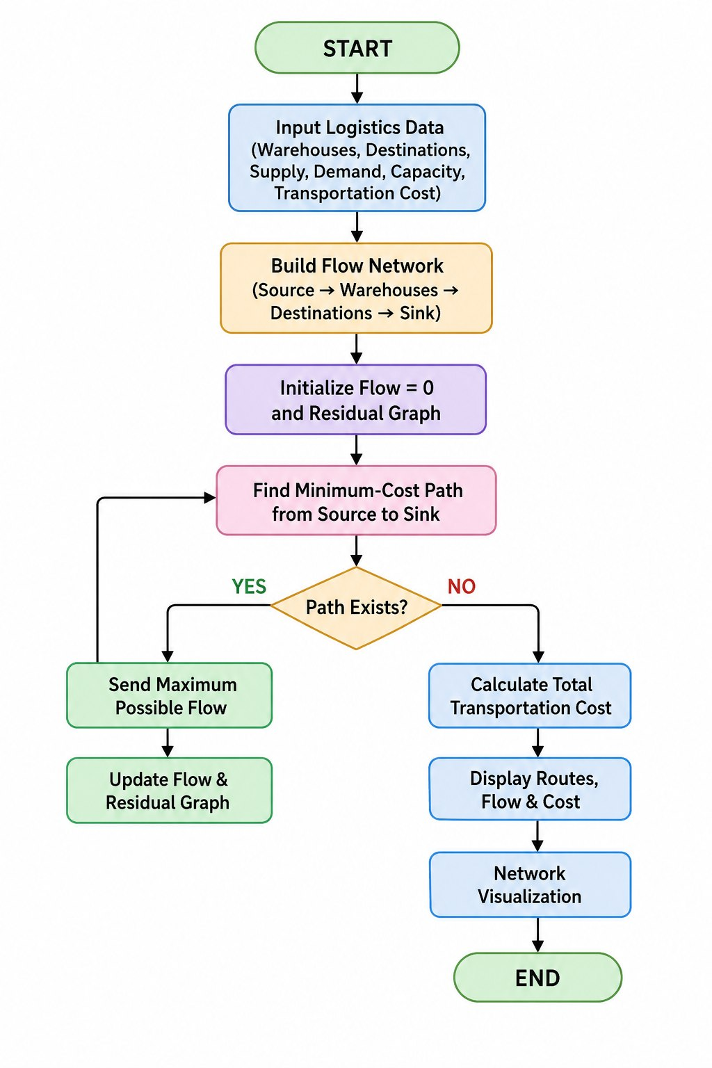
Flow Chart

Slide 7
Results
Successfully models the logistics problem as a flow network connecting warehouses and destinations.
Determines the optimal shipment quantity for each route while satisfying supply, demand, and capacity constraints.
Uses Minimum-Cost Maximum-Flow (MCMF) with the Successive Shortest Path (SSP) approach to minimize total transportation cost.
Generates route-wise flow and cost details for better decision-making.
Provides a network visualization of warehouses, destinations, routes, and optimized flows.
Helps reduce transportation costs and improve resource utilization compared with non-optimized route allocation.

Slide 8
Hardware and Software requirements
Hardware:
Intel Core i3+
4 GB RAM
500 MB storage
Software:
Windows/Linux/macOS
Java + JDK 17+
VS Code
MCMF using SSP
Git/GitHub (

Slide 9
Conclusion
The Logistics Optimization System successfully demonstrates the practical application of Minimum-Cost Maximum-Flow (MCMF) using the Successive Shortest Path (SSP) algorithm. By modeling warehouses, destinations, capacities, and transportation costs as a flow network, the system determines an efficient shipment allocation while minimizing the overall transportation cost.
The project shows how advanced network-flow algorithms can solve real-world logistics problems, improve resource utilization, and support better transportation decisions through optimized routes, cost reports, and network visualization.

Slide 10
Future Scope
Future Scope
- Support real-time transportation data and route updates.
- Add multiple optimization objectives such as time and fuel cost.
- Integrate GPS and live traffic information.
- Handle larger and more complex logistics networks.
- Add demand forecasting for better shipment planning.
- Develop recommendations for dynamic route optimization.

Slide 11
Thank you

